Slide 1


An introduction to Hackathons and how to get started in Python and data science
13th March 2019
Download me
James Smith
CTO
www.projectingsuccess.co.uk
Page 1 | 06/03/2019 | | www.projectingsuccess.co.uk

Slide 2
Overview
Introduction
9:30 - Introduction
Mini Hackathon
10:00 - Exercise - How to tackle data analytics problems. Group work (part_1)
10:30 - Python masterclass class - An introduction to web scraping
11:00 – Challenge 1 Group work (part_2)
12:00 – Team presentations
12:30 – Lunch
13:30 – Challenge 2. Group work (part_1)
14:00 - Python masterclass/exercise class - An introduction to machine learning
14:30 – Group work (part_2)
15:30 – Team presentations
16:00 – Finish/Feedback

Slide 3
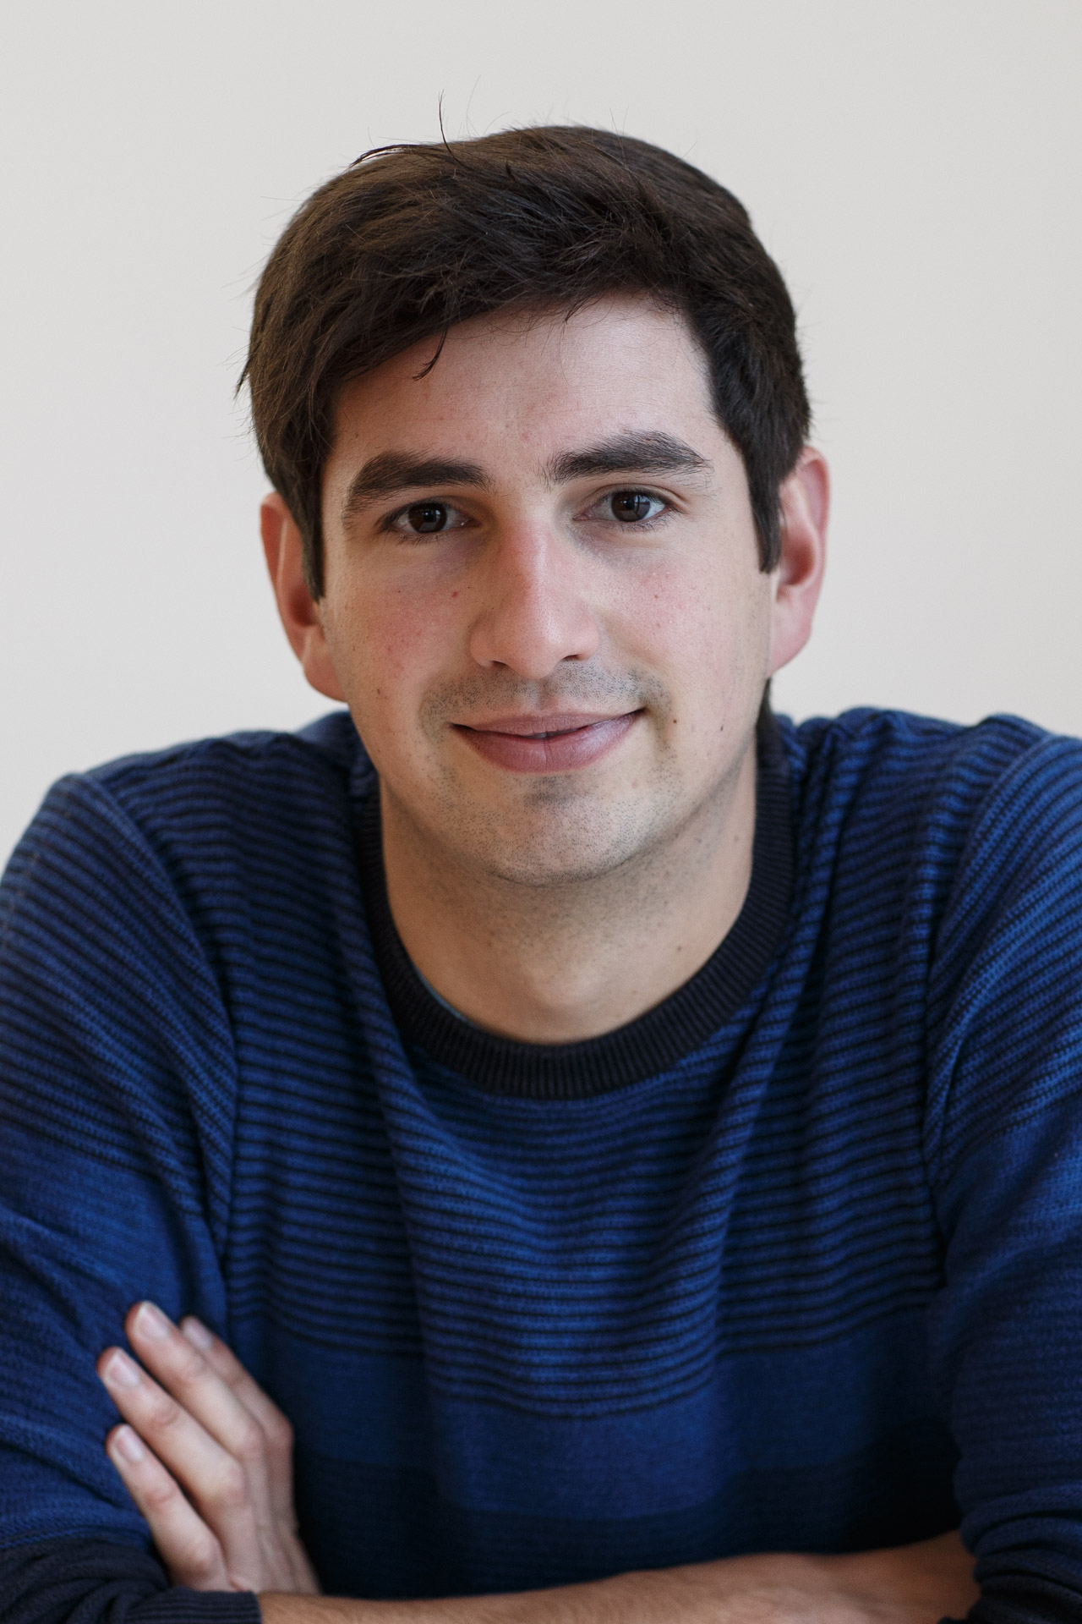
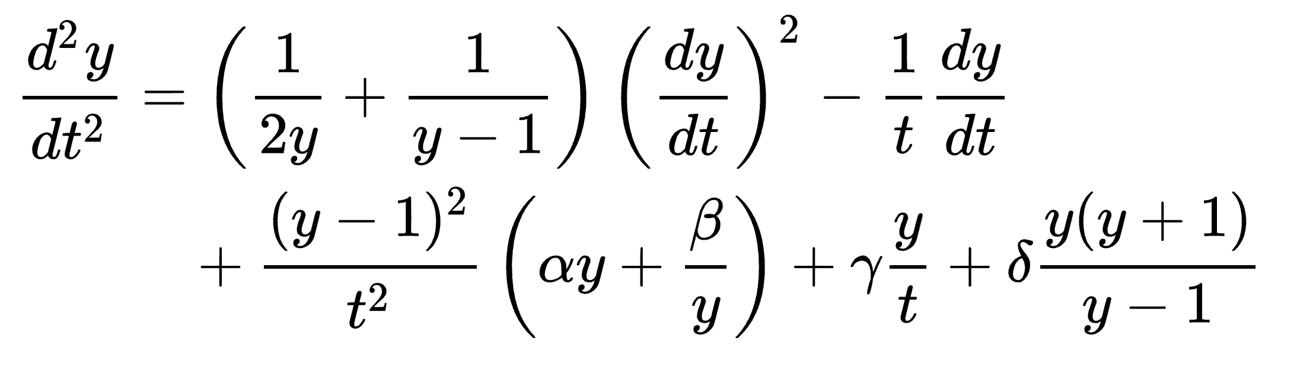


Who am I?
Completed my PhD in applied Mathematics in 2015 – Painlevé equations and Orthogonal Polynomials
Lectured mathematics at the University of Kent
Joined Projecting Success in 2017
Interests:
Mathematics
Machine Learning
Python

Slide 4
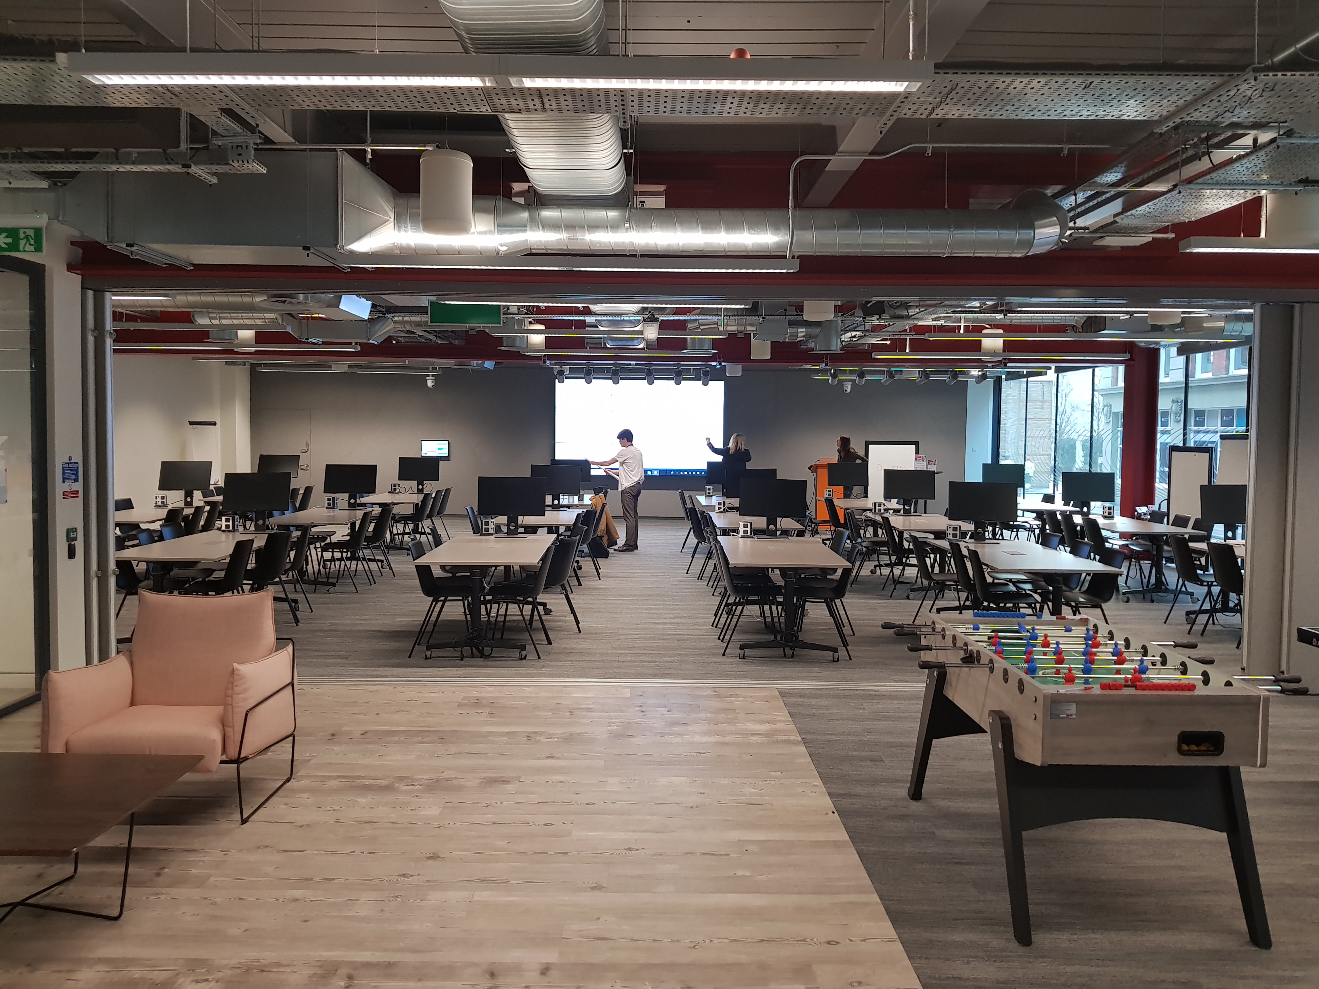
What is a Hackathon?
An event, typically lasting several days, in which a large number of people meet to engage in collaborative computer programming.
The delegates have a diverse range of skills.
Intensive problem solving

Slide 5
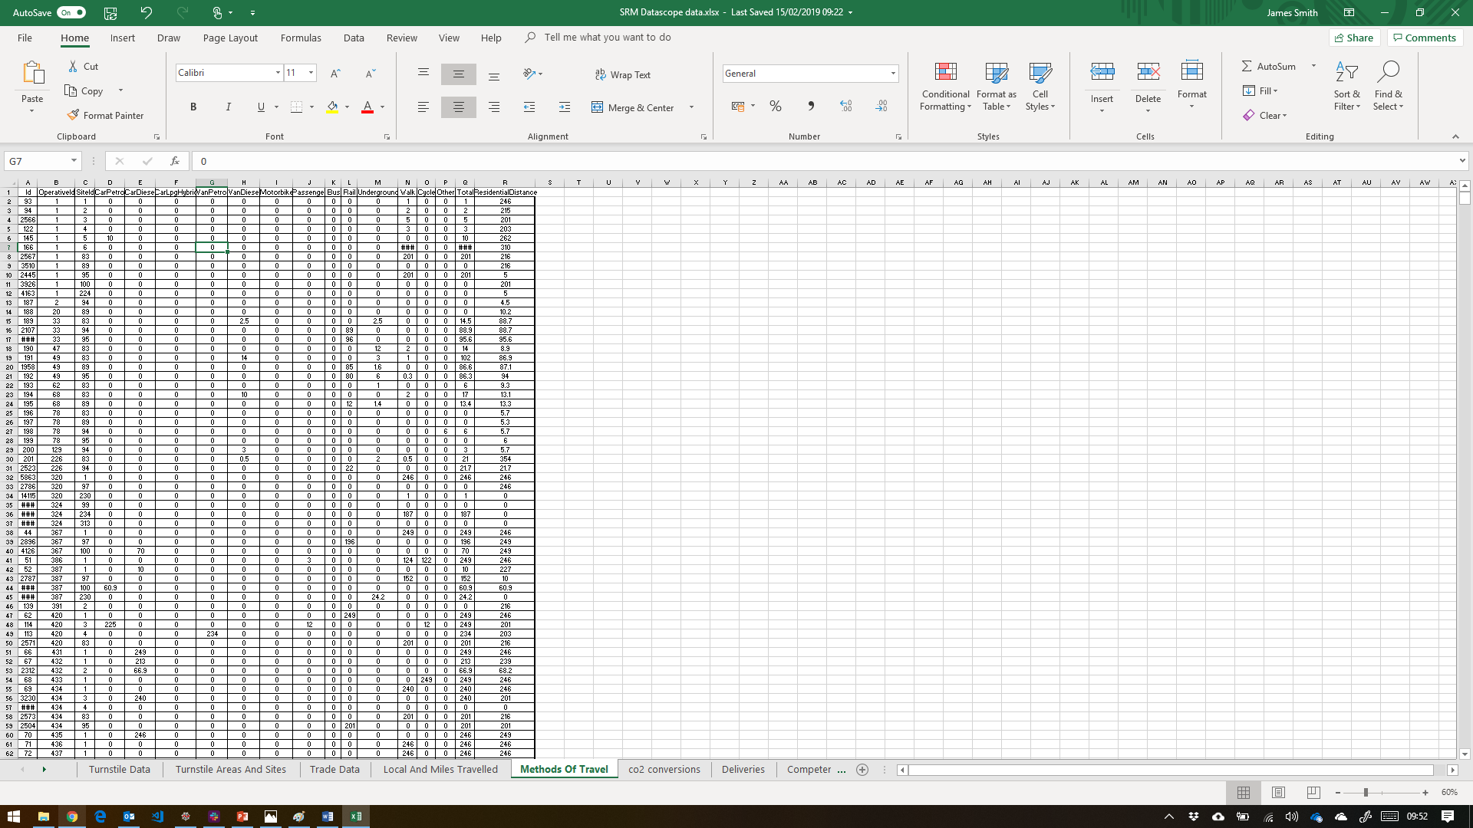
Behind the scenes
Data anonymisation.
Data cleansing.
Creation of challenges.
Validation of challenges.
Event planning
13 Challenges
101 Attendees
120 Bacon sandwiches eaten
1212 Hours worked
5 Masterclasses
1.62GB Datasets crunched
3 Million rows if data analysed
15 Business driven solutions proposed
£1000 Prizes given

Slide 6
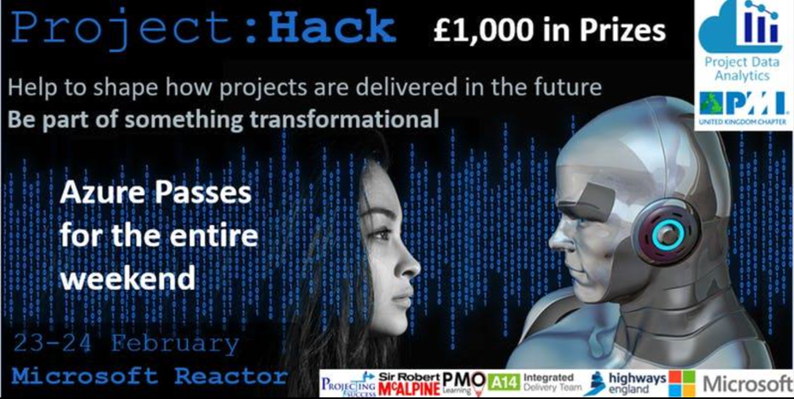

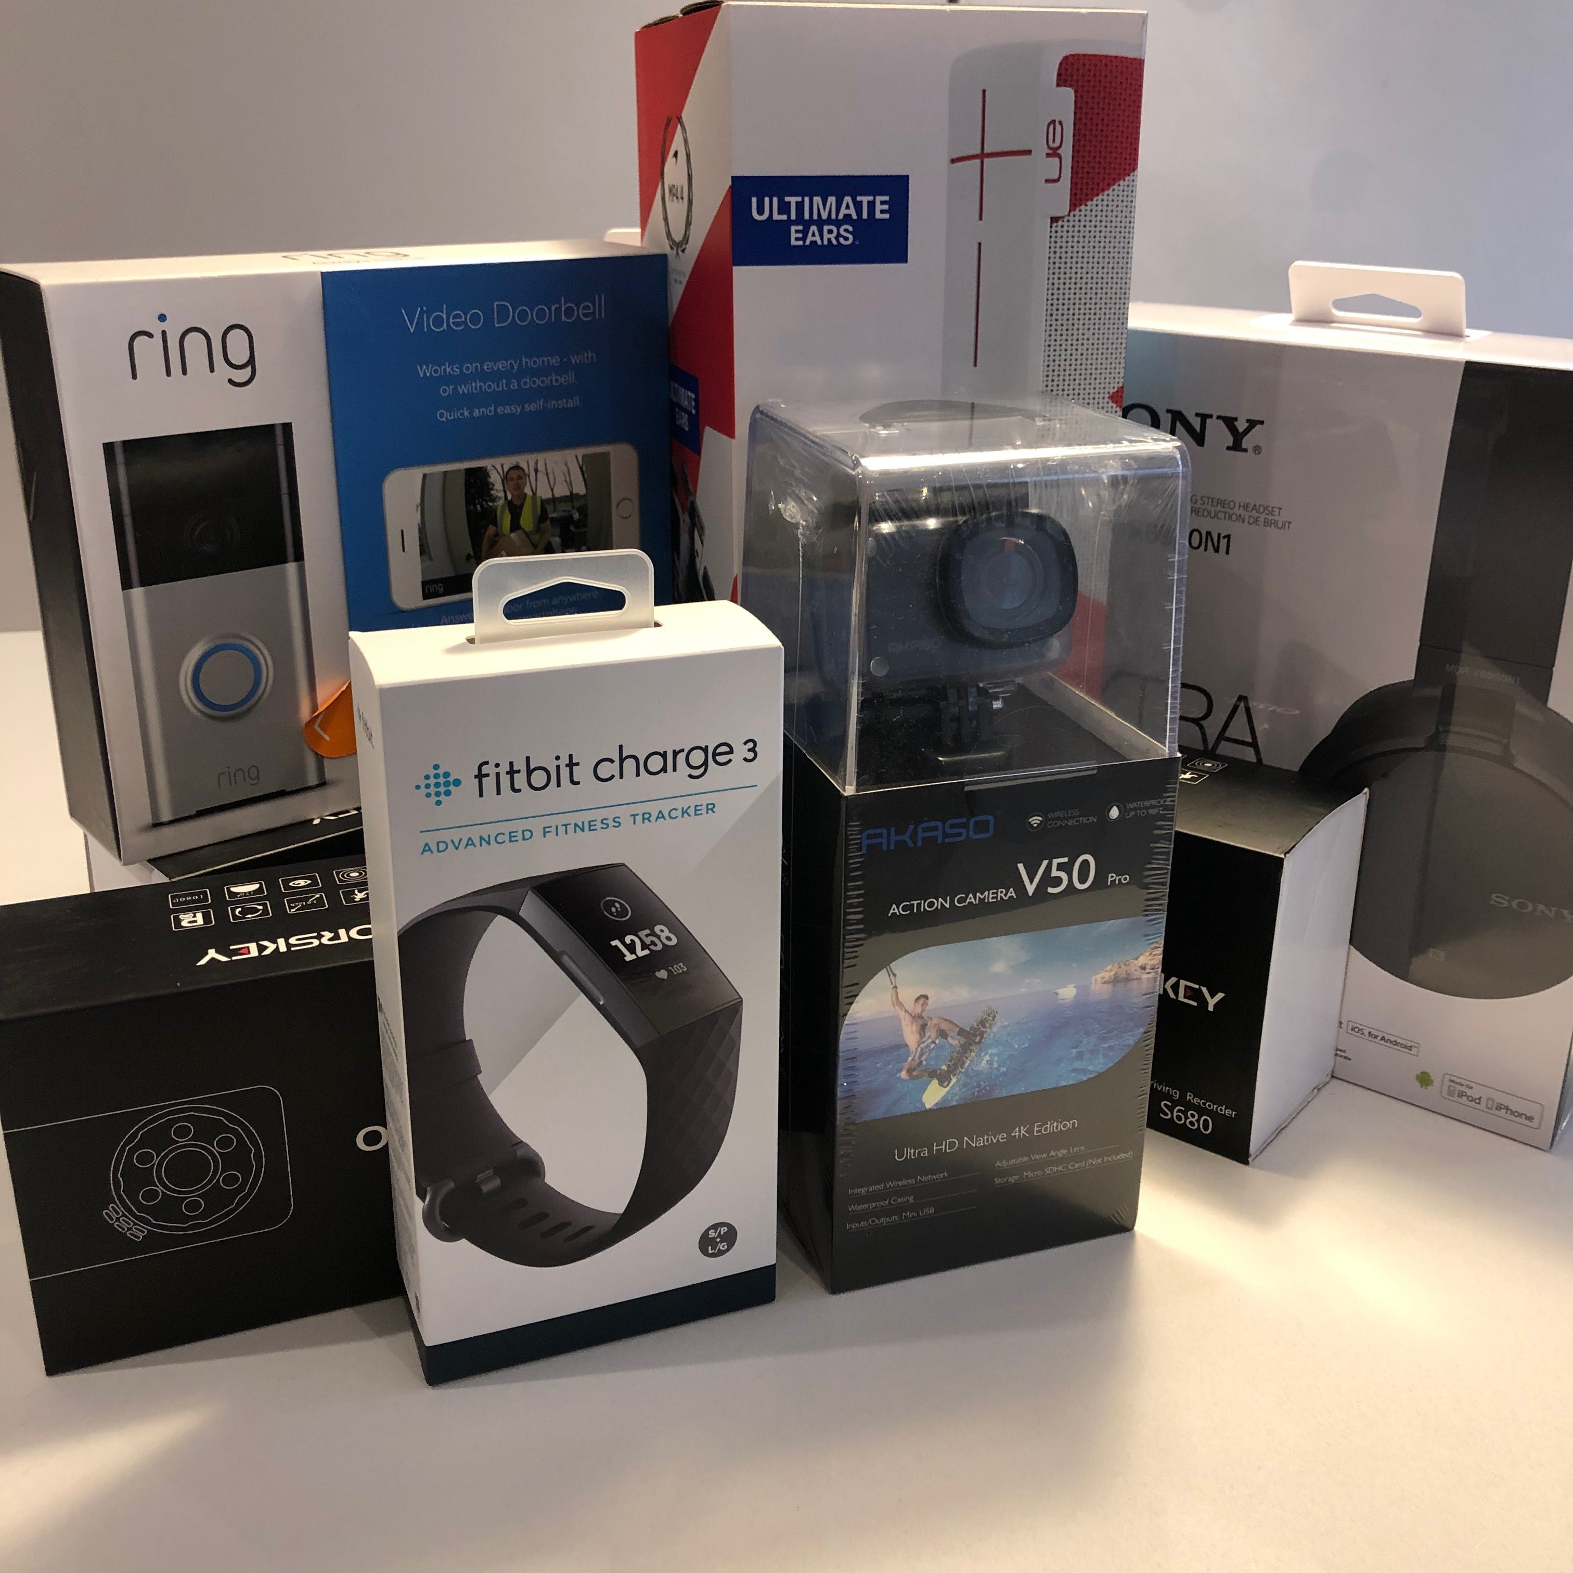
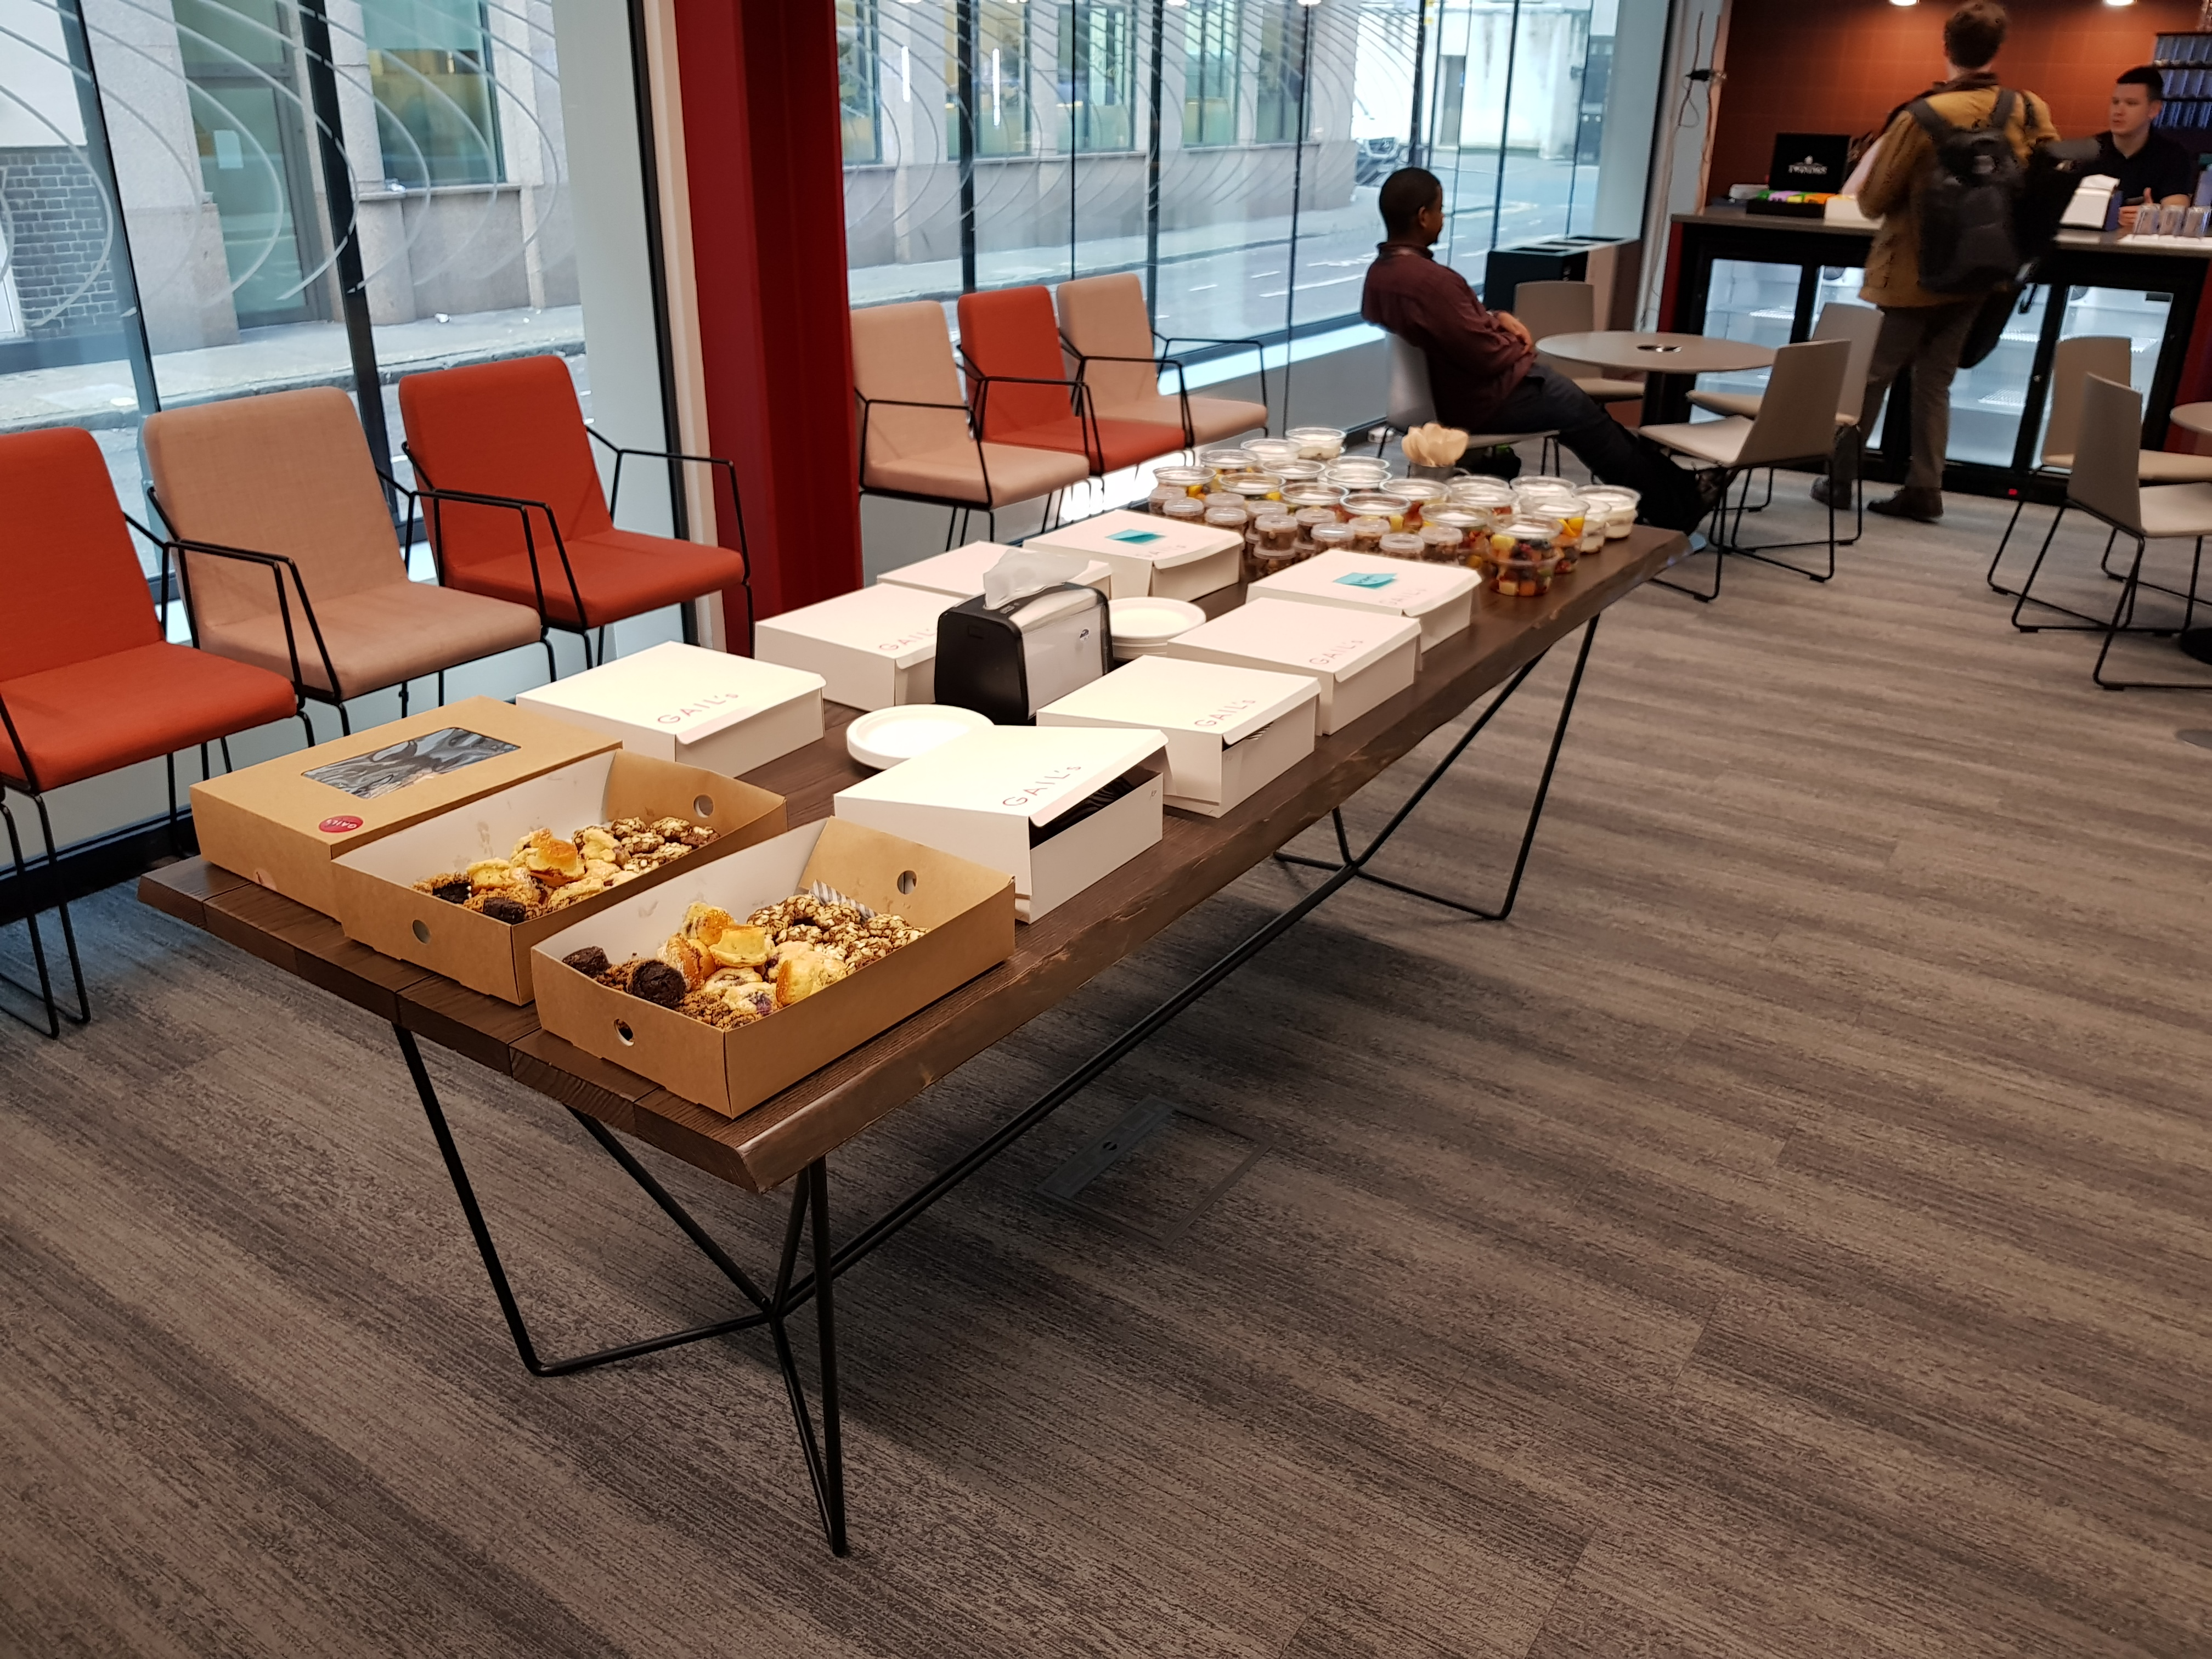
Walk through of the first/second day
Breakfast.
Summary of the challenges. The challenges have been set by industry specialists with knowledge of the particular sector.
Time to think about what you’d like to do.
An opportunity to deliver a 60 second pitch to everyone, if you want to.
Teams will then form. Either around the challenges or your vision that you have pitched. Max 6 people per team.
Hack, hack, hack.
We’ll then have 2 panels of judges. Your team will deliver a 5 min pitch to the panel after lunch on Sunday.
The winning team from each panel will go to a head judging panel. You’ll have a 7 min pitch. The judges will then deliberate.
Prizes will then be awarded on a team and personal basis.

Slide 7


Exercise – How to tackle data analytics problems
Use cases
?
?
?

Slide 8

10:00 - What Problems are we Trying to Solve?
User stories
As a …… I want to….. so that I can…..
30 minutes
User story: Example
As a project manager I want to understand what challenges are likely to arise in the next 12 months, including how likely they are and their potential impact so that I can take action to manage or mitigate.
5 user stories: in groups of, say 5?
Consider the full range of roles
https://www.ogauthority.co.uk/lessons-learned/

Slide 9


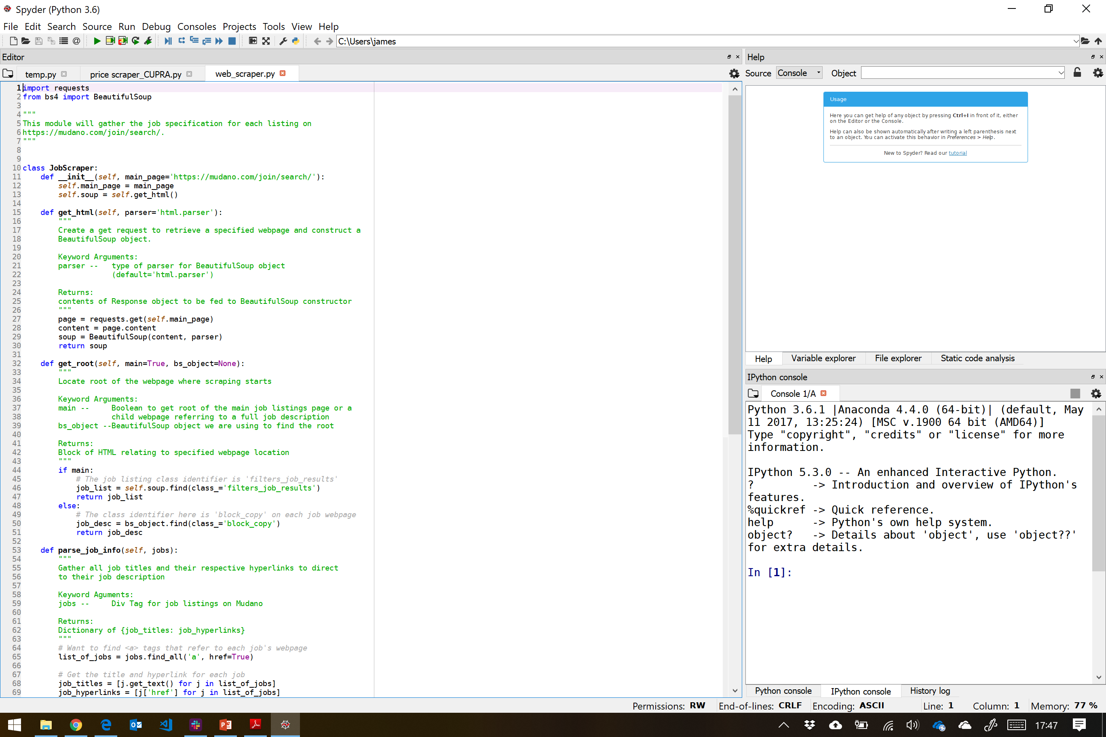

10:30 - Python Masterclass – An intro to web scraping
30 minutes
Intro to Google Colab
https://www.ogauthority.co.uk/lessons-learned/
Google Colab
GitHub_1
GitHub_2

Slide 10
11:00 – Challenge 1
60 minutes
Solve user stories from the exercise above (Conceptually if necessary)
Groups of, say 5?

Slide 11

12:00 – Team presentations
30 minutes
Dropbox

Slide 12

12:30 – Lunch
60 minutes

Slide 13
13:30 – Challenge 2
30 minutes
Using ICT data can we predict how much a project is likely to slip (cost or schedule)?
Groups of, say 5?

Slide 14
14:00 - Python masterclass/exercise
30 minutes
Intro to Google Colab
Google Colab
GitHub

Slide 15
14:30 – Group work
60 minutes
Using ICT data can we predict how much a project is likely to slip?
Groups of, say 5?

Slide 16
15:30 – Team presentations
30 minutes

Slide 17
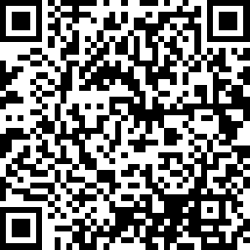
16:00 – Finish/Feedback
Thanks for listening
https://www.surveymonkey.co.uk/r/8LP2WR3

